Slide 1
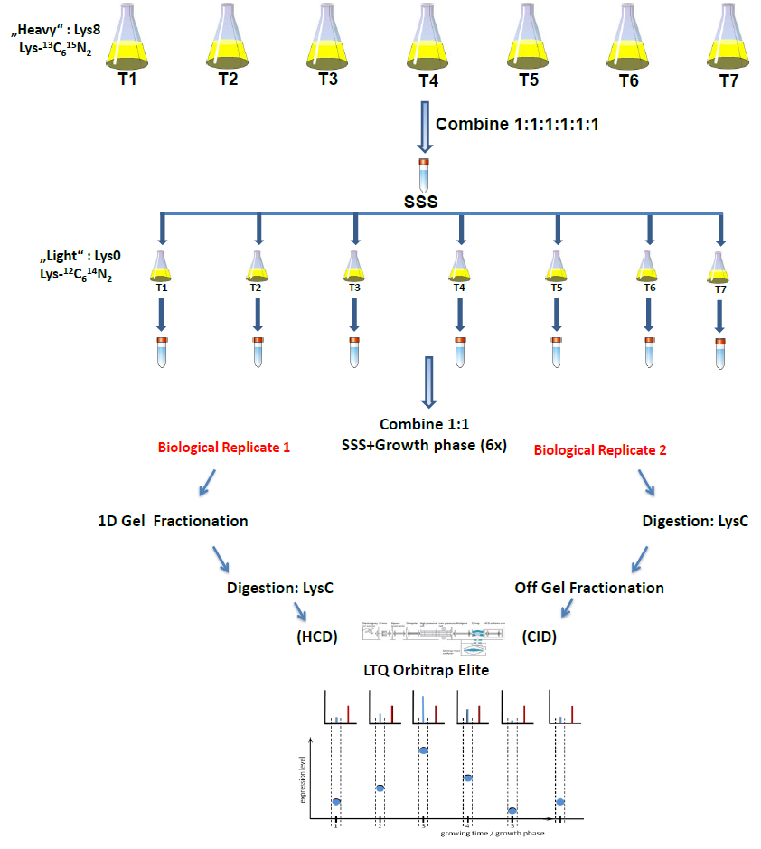
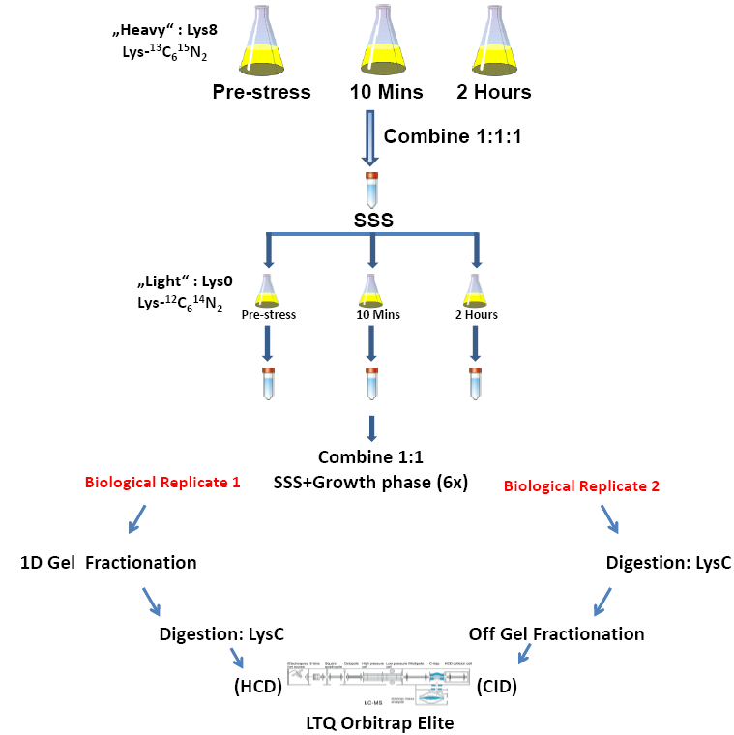
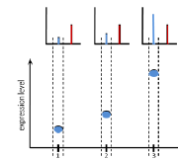
A.
B.
Notes:
Supplementary Figure 1. Super-SILAC Workflow. A. Seven independent SILAC labeled cell cultures were harvested at different time-points during normal growth in Lys8. All protein extracts were mixed in equal amounts to obtain the Super SILAC Standard (SSS). Separate cultures at each growth stage were grown in Lys0 and mixed 1:1 with the SSS. B. Three independent SILAC labeled cell cultures were harvested at different time-points during ethanol stress (4%v/v) in Lys 8. All protein extracts were mixed in equal amounts to obtain the SSS. Separate cultures at each ethanol stress time-point (4%v/v) were grown in Lys0 and mixed 1:1 with the SSS. All experiments were performed in two separate biological replicates each consisting of different methods of protein/peptide fractionation and fragmentation.

Slide 2
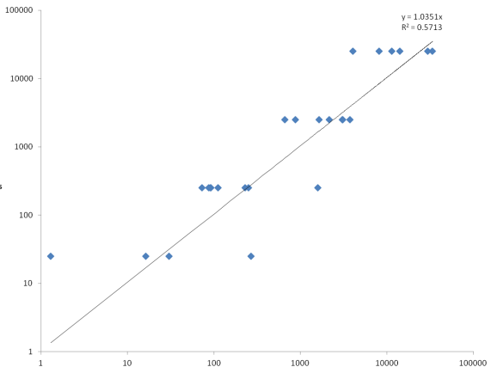
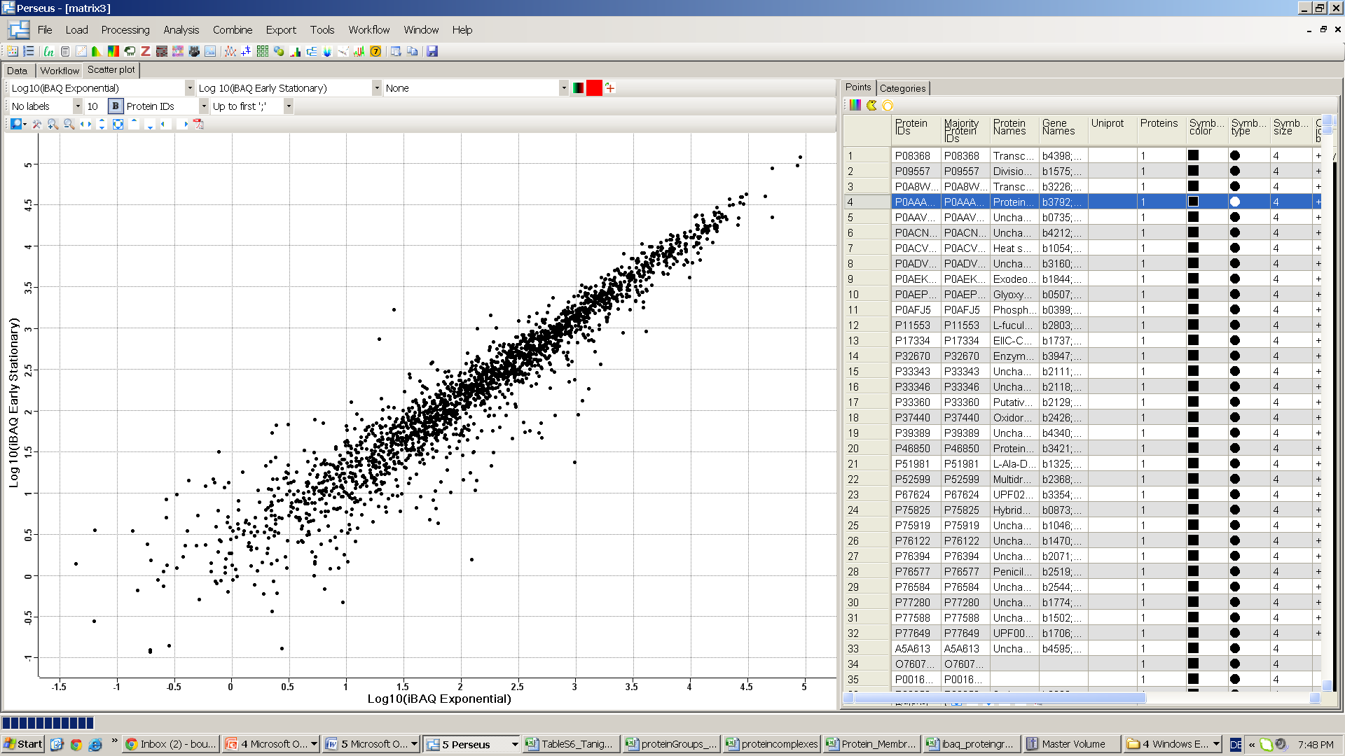
A.
B.
Log10 Femtomoles
Log10 iBAQ Values (ES)
Log10 iBAQ Values
Log10 iBAQ Values (Log)
Notes:
Supplementary Figure 2. Performance of iBAQ standard in terms of reproducibility. A. Correlation between UPS2 iBAQ standard and femtomolar amounts revealed good correlation levels. B. Pearson correlation of iBAQ intensities derived from TP3 vs TP5 showed a high level of correlation with few outliers.

Slide 3
A.
B.
Notes:
Supplementary Figure 3. Economics of protein synthesis in E.coli. During growth in minimal media, bacteria have evolved the capacity to prioritize which proteins/functions are required to be synthesized based on necessity. A. Glycolytic enzymes which are essential for growth and survival either increase or stay constant regardless of their growth stage (sold lines represent ratios; dashed lines represent copy numbers). B. On the contrary, cold shock proteins whose exclusive function is to respond upon cold shock decrease in their protein synthetic rates during later stages of growth, as they are considered as essential in stationary phase specific growth conditions.

Slide 4
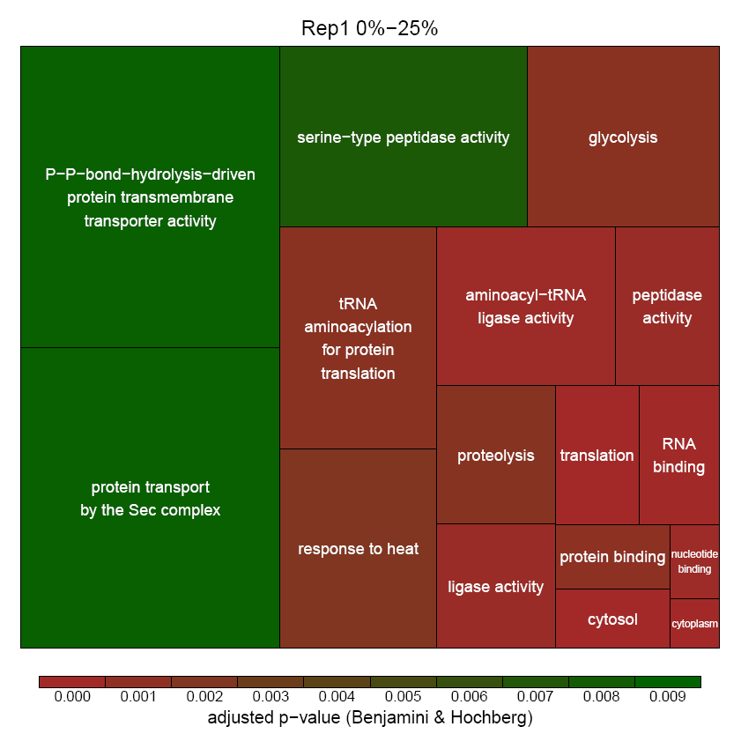
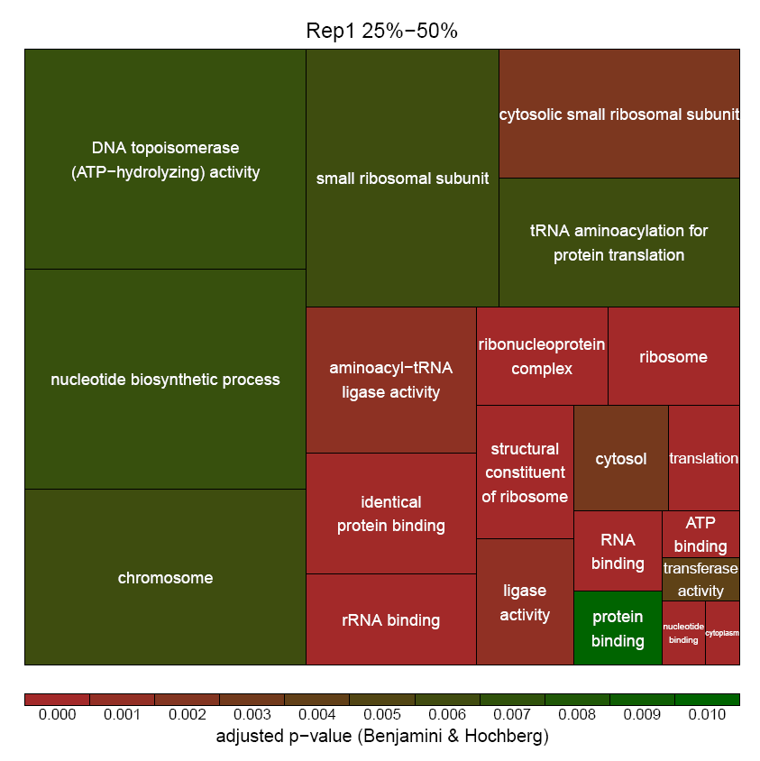
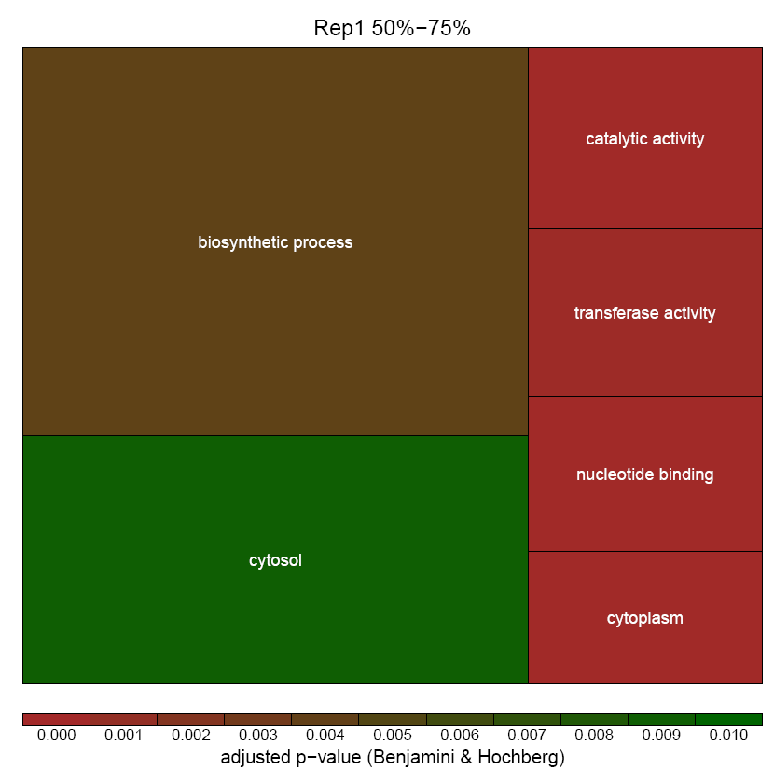
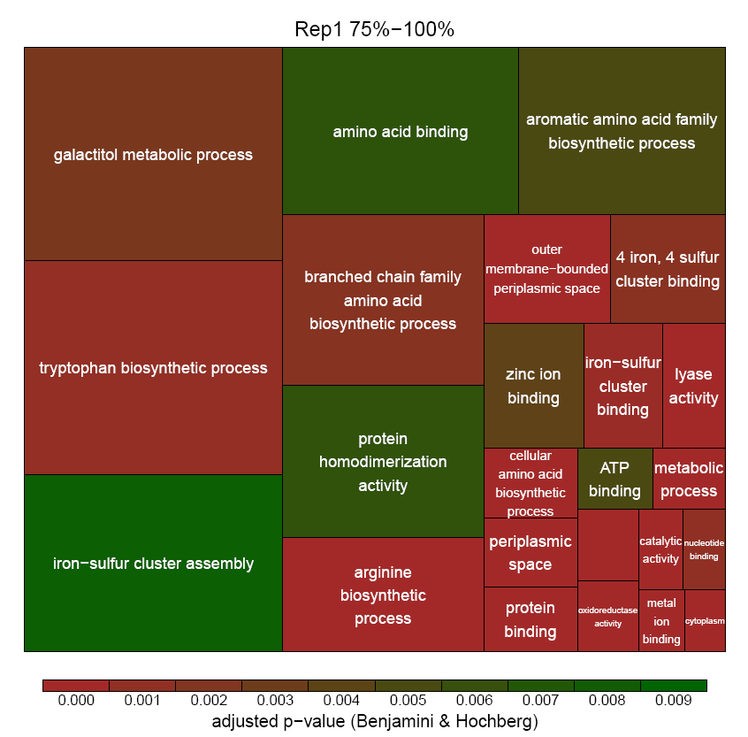
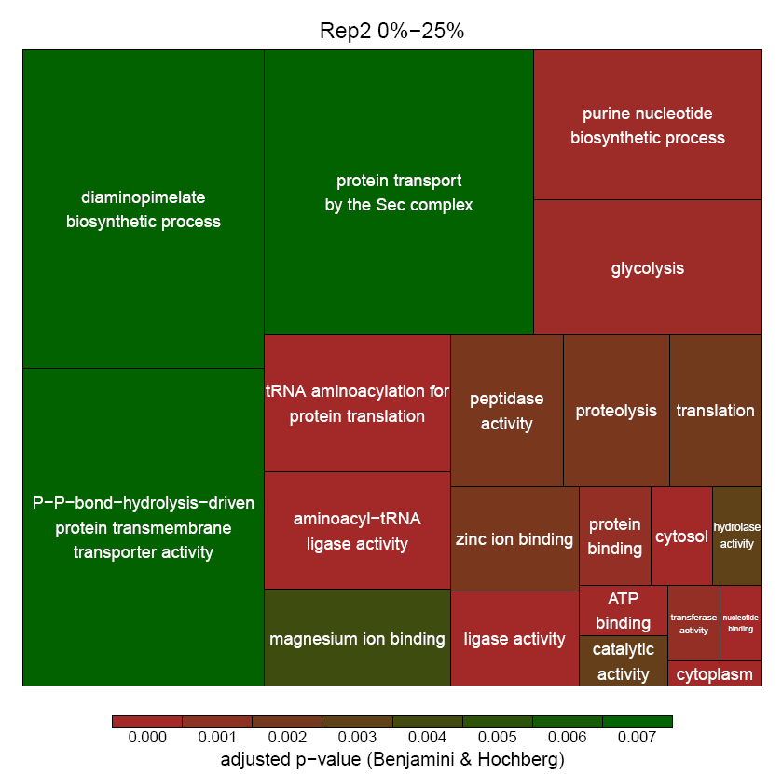
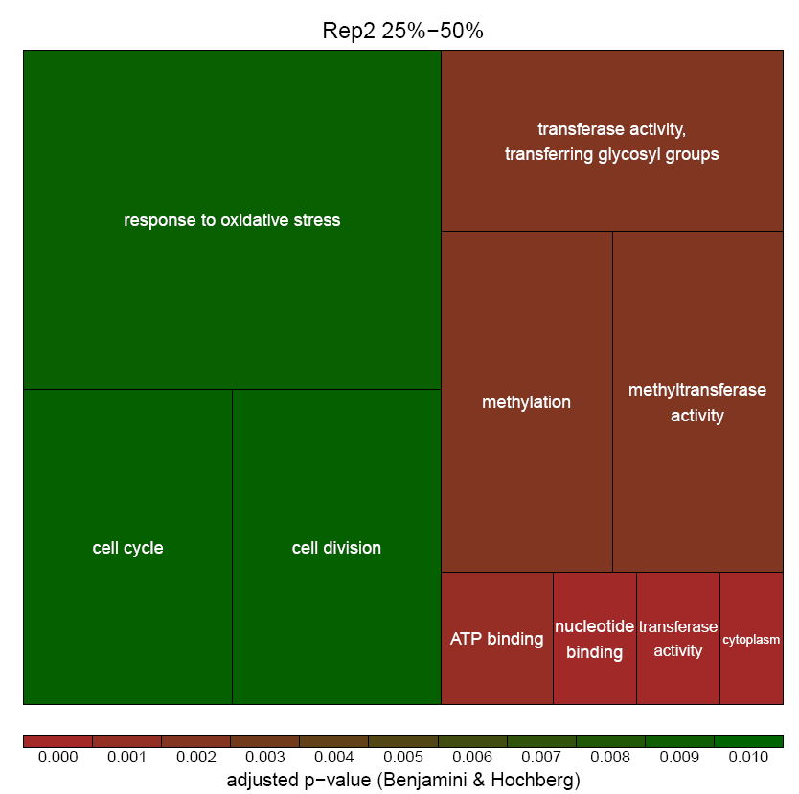
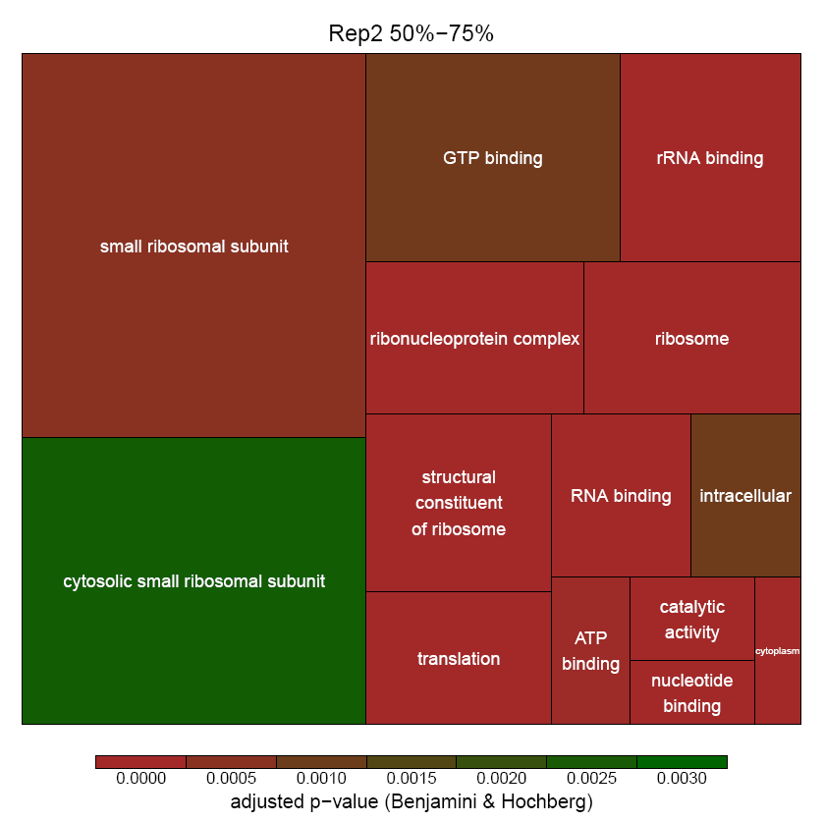
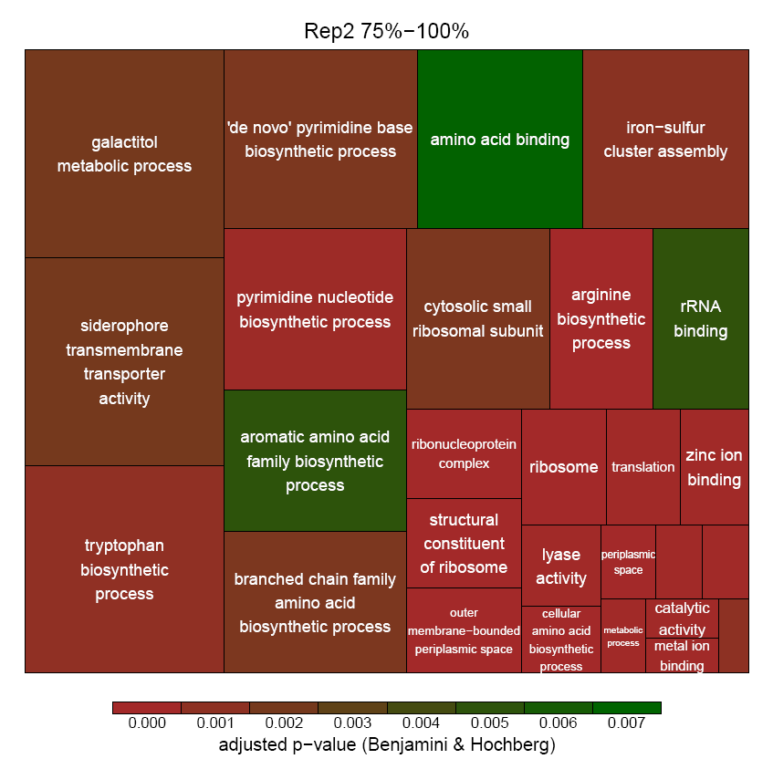
GO enrichment analysis on bins of standard deviations
1. quartile
2. quartile
3. quartile
4. quartile
Rep1
Rep2
Notes:
Supplementary Figure 4. GO enrichment analysis of standard deviation bins during E.coli growth. The magnitude of protein fluctuation was expressed by calculating the standard deviation of the log-transformed ratios across the growth phases or time points. The resulting quartiles of the distribution were used to bin proteins according to the extent of fluctuation. Those belonging to the quartile with the highest standard deviation (75-100 %) were defined as “fluctuating” or dynamic, whereas those belonging to the quartile with the lowest standard deviation (0-25 %) were defined as “non-fluctuating” or static.

Slide 5
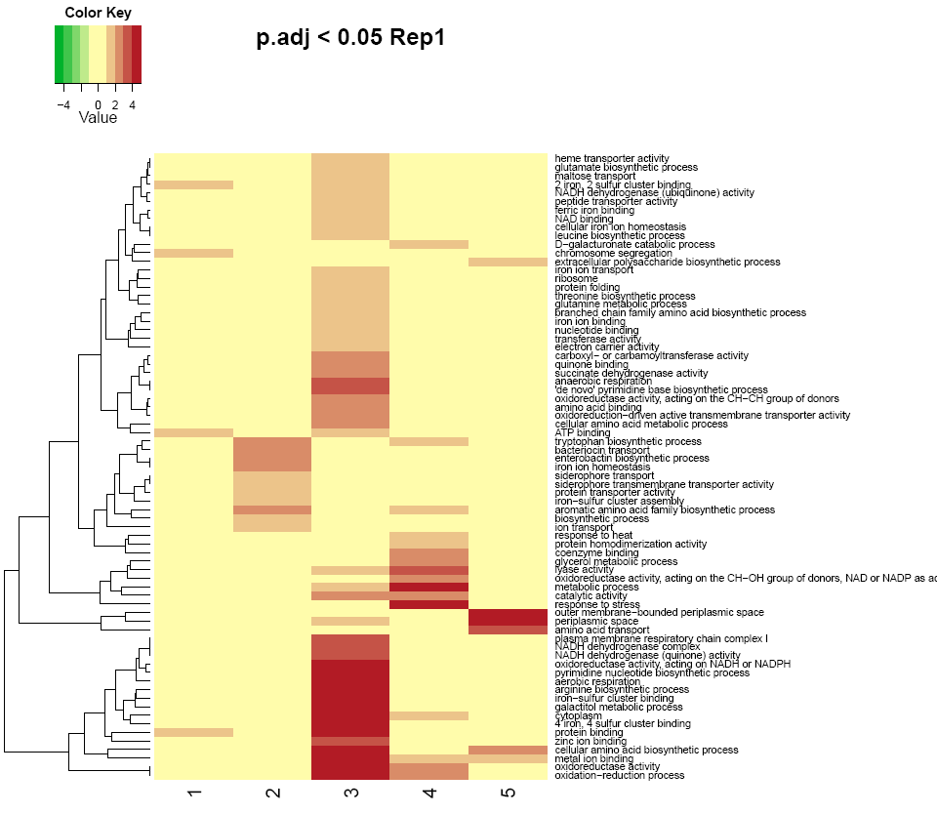
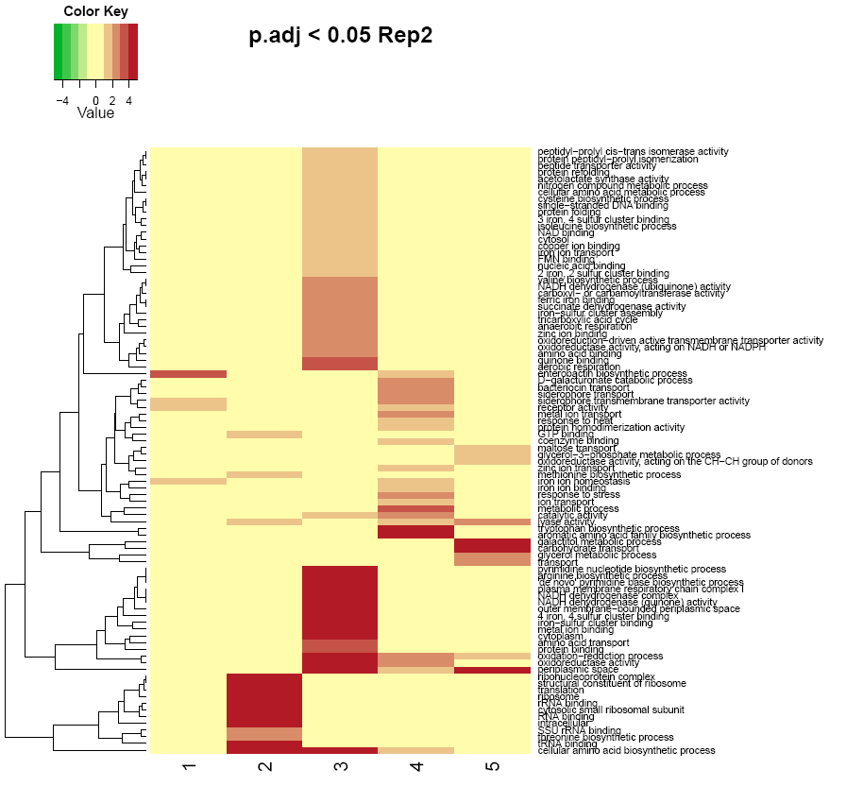
Hierarchical clustering – GO enrichment
25% of top changing proteins
Notes:
Supplementary Figure 5. GO enrichment analysis of Hierarchical clustering during E.coli growth. GO enrichment analysis was performed on the 5 clusters of the 25% significantly changing proteins during growth (Fig 3A.)

Slide 6
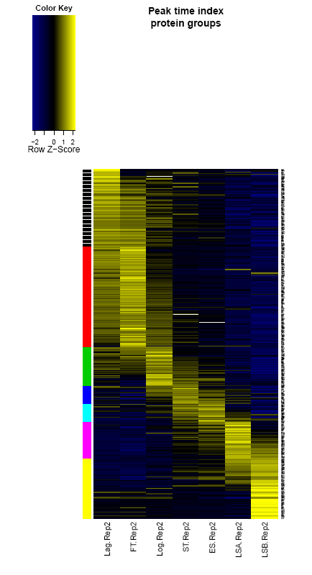
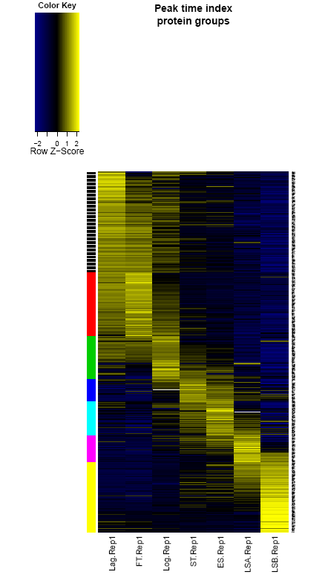
Peak time index calculation
25% of top changing proteins
Rep1
Rep2
Notes:
Supplementary Figure 6A. Peak time index during E.coli growth. For each protein we determined the experimental condition of its highest expression per growth condition. B. To assign the resulting ‘peak time index’ of every protein to a specific growth phase respective time point, we applied hierarchical clustering on these values using the Euclidian distance and a defined cluster numbers of seven (growth phase).

Slide 7
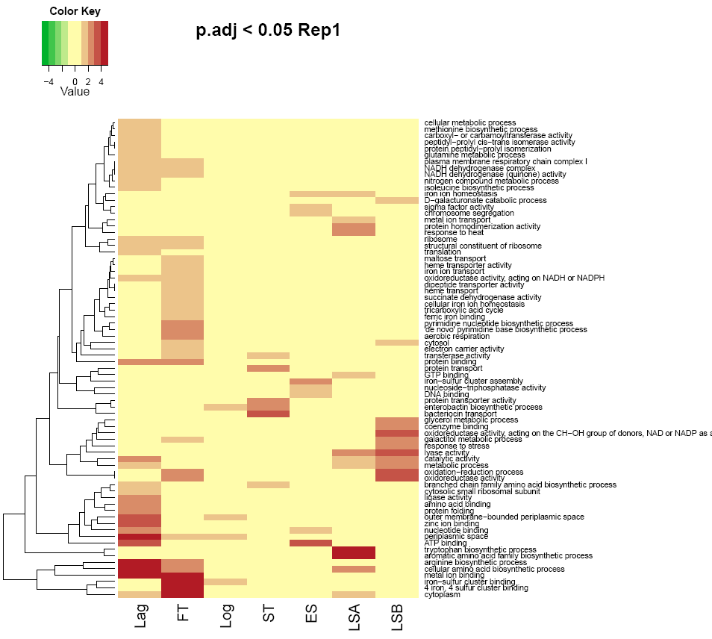
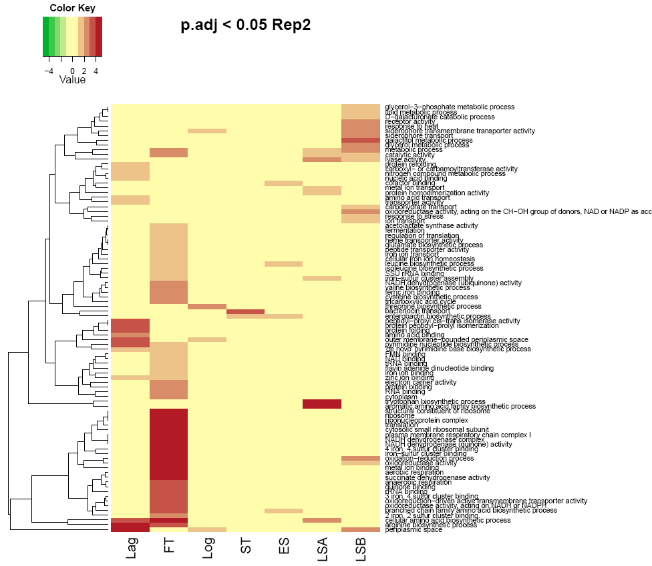
Peak time index calculation – GO enrichment
25% of top changing proteins
Rep1
Rep2
Notes:
Supplementary Figure 6B. Peak time index during E.coli growth. To assign the resulting ‘peak time index’ of every protein to a specific growth phase respective time point, we applied hierarchical clustering on these values using the Euclidian distance and a defined cluster numbers of seven (growth phase).

Slide 8
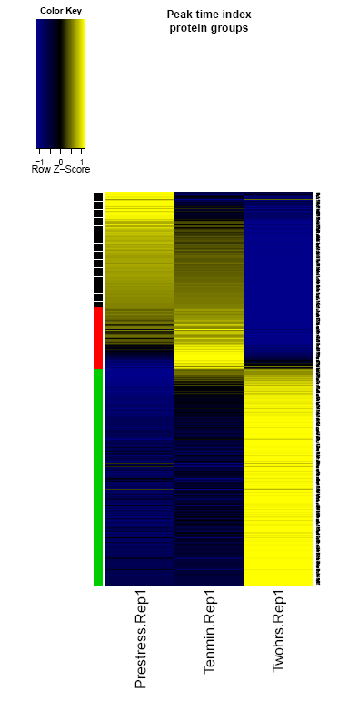
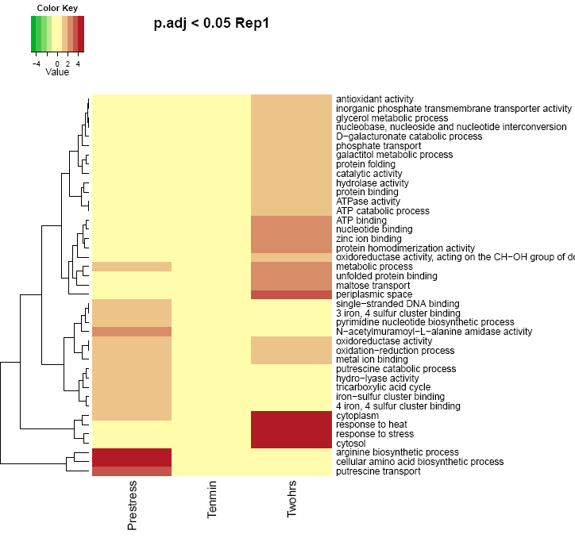
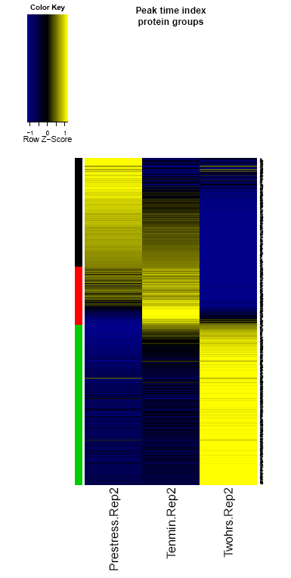
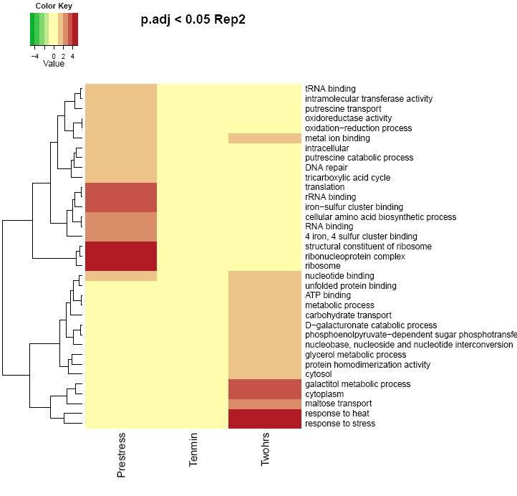
A.
B.
Replicate 1
Replicate 2
Notes:
Supplementary Figure 7. Peak time index during E.coli ethanol stress. For each protein we determined the experimental condition of its highest expression per ethanol stress condition. To assign the resulting ‘peak time index’ of every protein to a specific growth phase respective time point, we applied hierarchical clustering on these values using the Euclidian distance and a defined cluster numbers of three (ethanol stress time points). Replicate 1 (A.) and Replicate 2 (B.) are shown above.

Slide 9
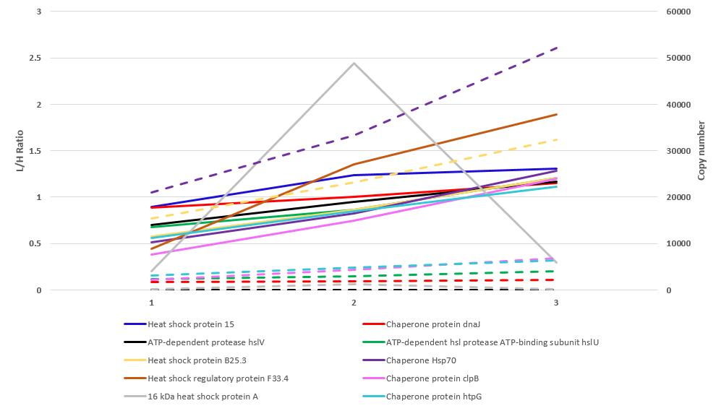
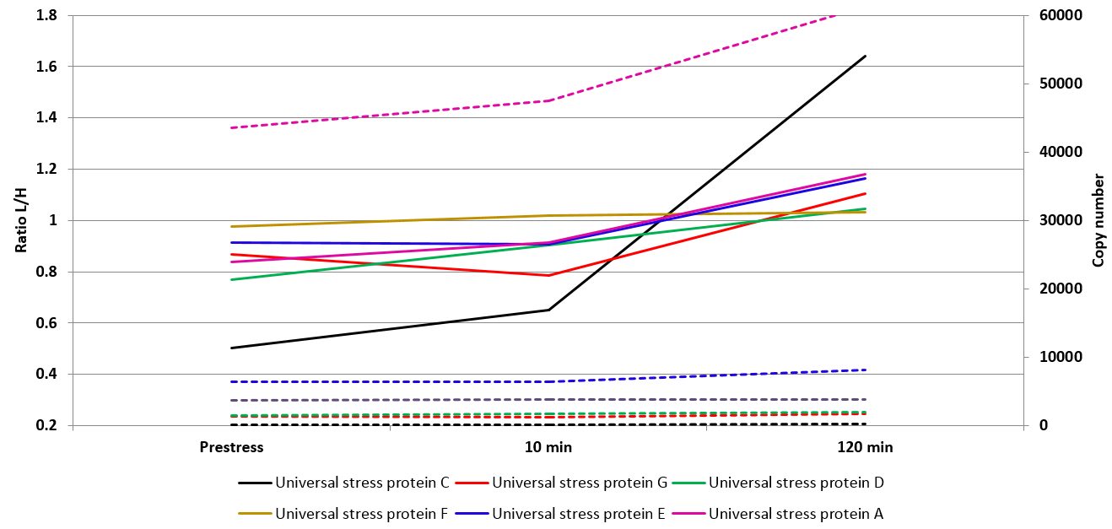
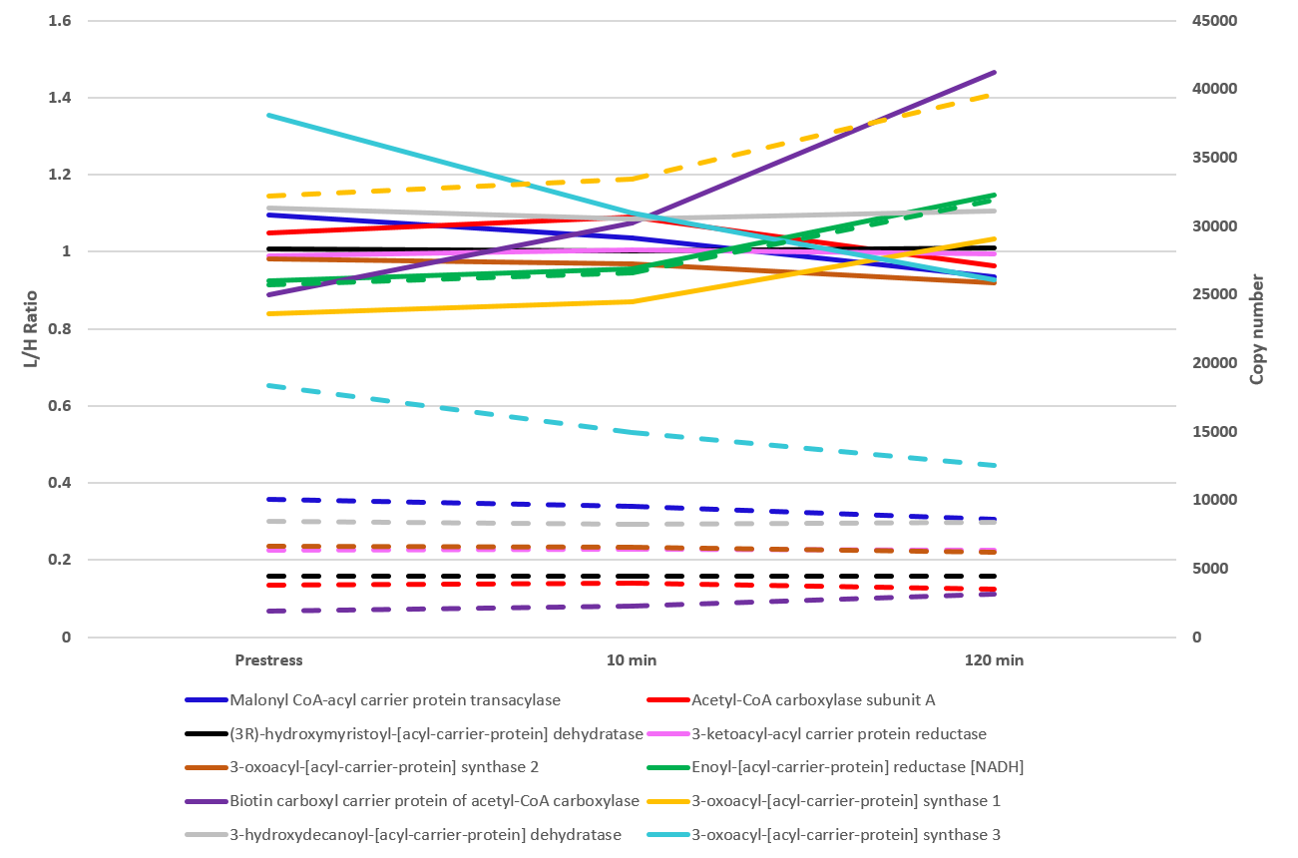
A.
B.
C.
Notes:
Supplementary Figure 8. A. Relative and Absolute protein dynamics of heat shock proteins during growth in E.coli. B. Relative and Absolute protein dynamics of Universal stress proteins during ethanol stress in E.coli. C Relative and Absolute protein dynamics of identified proteins involved in unsaturated fatty acid synthesis during ethanol stress in E.coli.

Slide 10
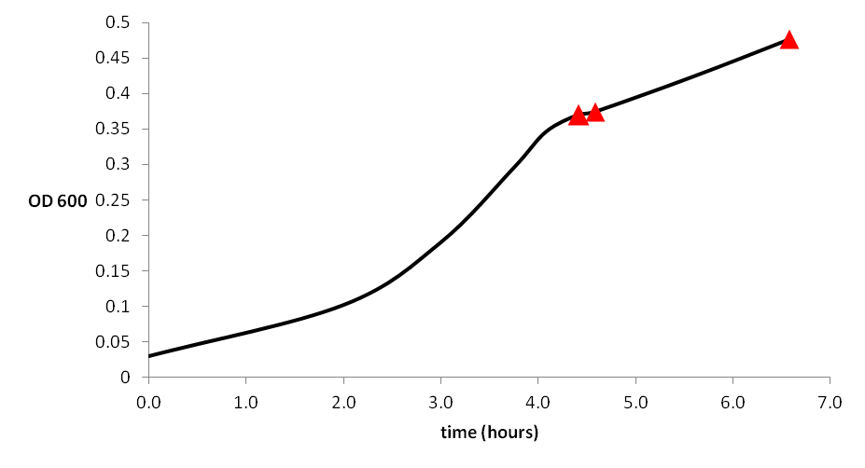
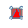
A.
B.
T5
T6
T7
T4
OD 600
T3
T1
T2
1800
5760
Time (min)
Notes:
Supplementary Figure 9. In vitro growth curve in minimal M9 SILAC medium. Red markers indicate points where cells were harvested for proteome analysis. A. Growth under „normal conditions“. B. Growth under ethanol stress conditions (4% v/v ethanol).

Slide 11
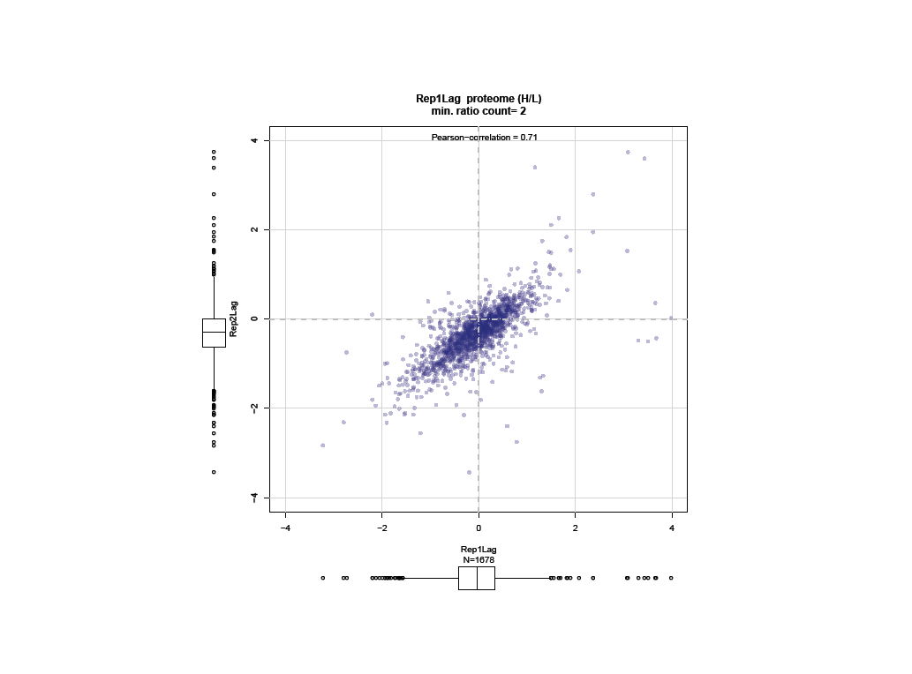
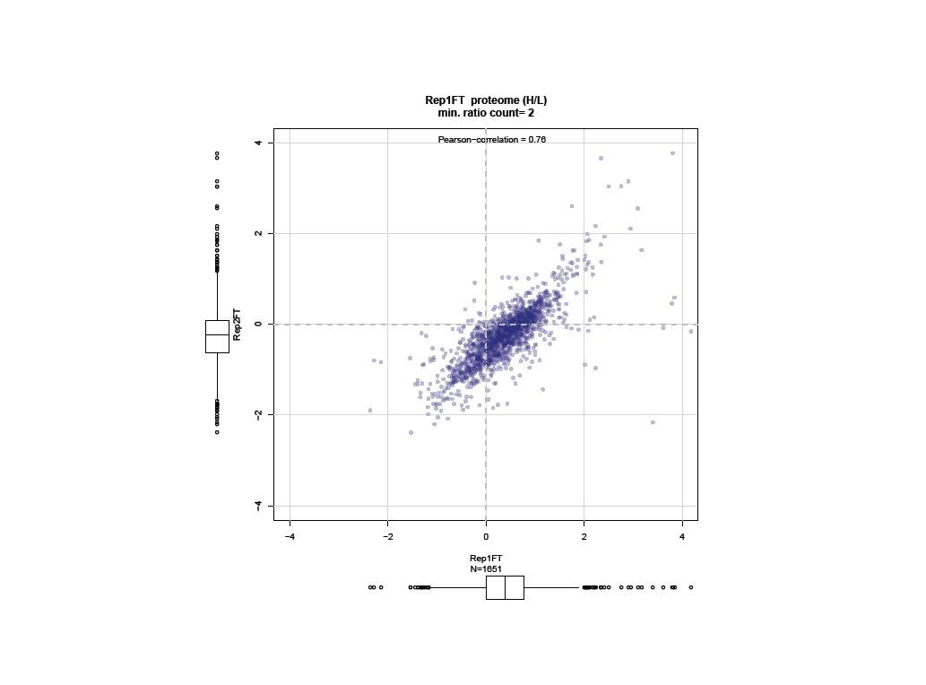
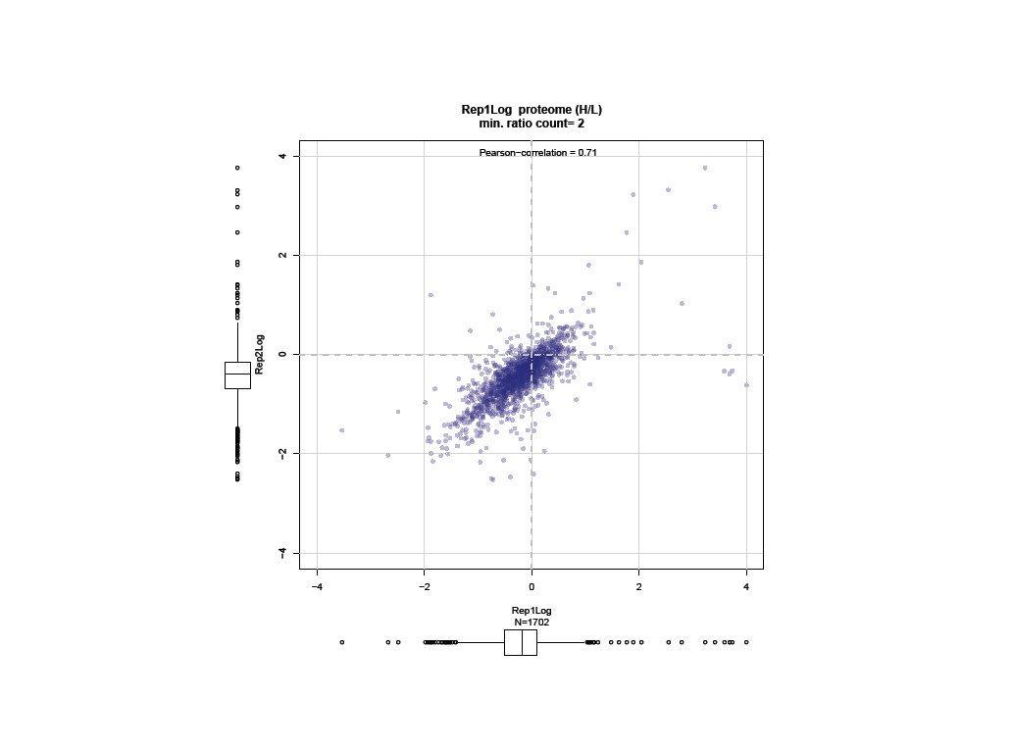
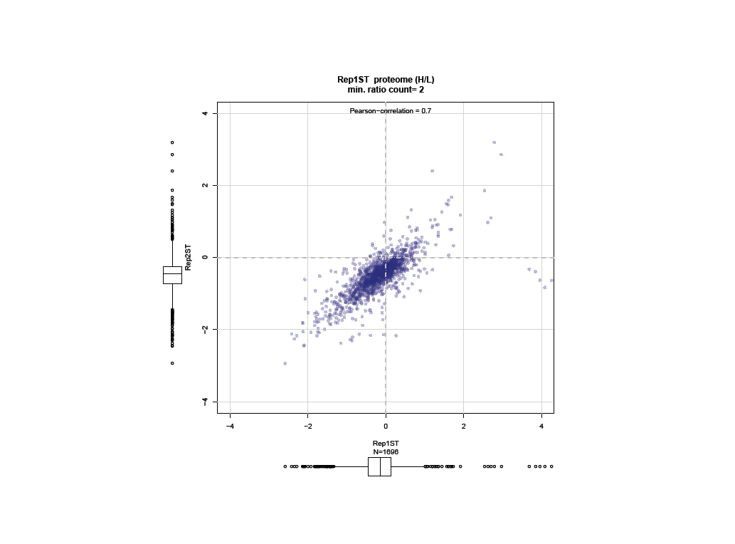
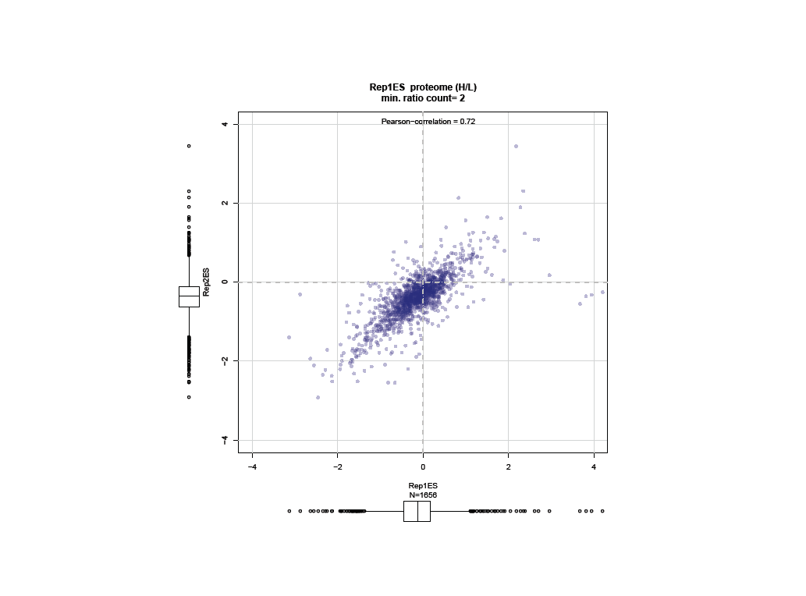
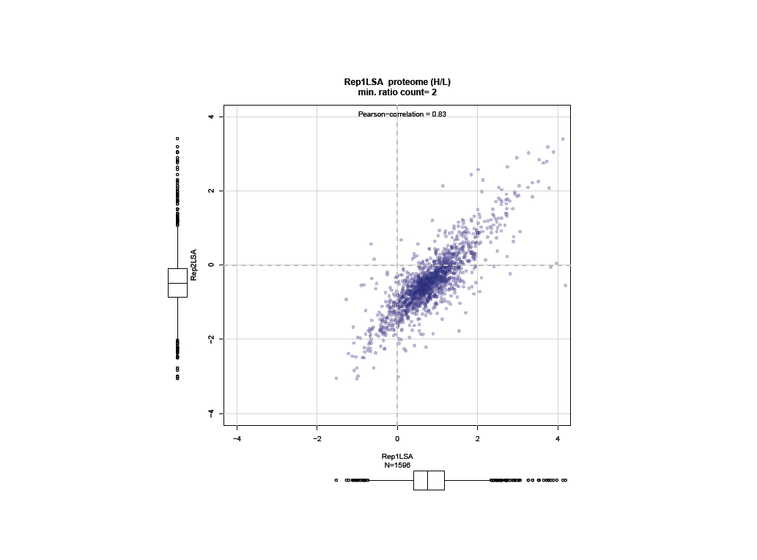
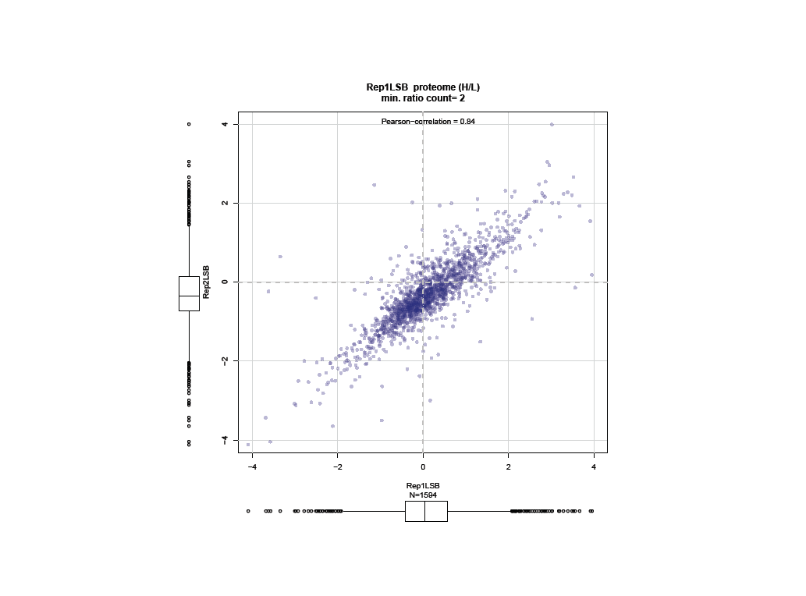
TP1
TP2
TP3
TP4
Pearson correlation= 0.71
Pearson correlation= 0.76
Pearson correlation= 0.71
Pearson correlation= 0.70
TP5
TP6
TP7
Pearson correlation= 0.72
Pearson correlation= 0.83
Pearson correlation= 0.84
Notes:
Supplementary Figure 10. Reproducibility between biological replicates. A. Pearson correlation between normalized protein ratios between biological replicates for all seven growth phases during growth experiment.

Slide 12
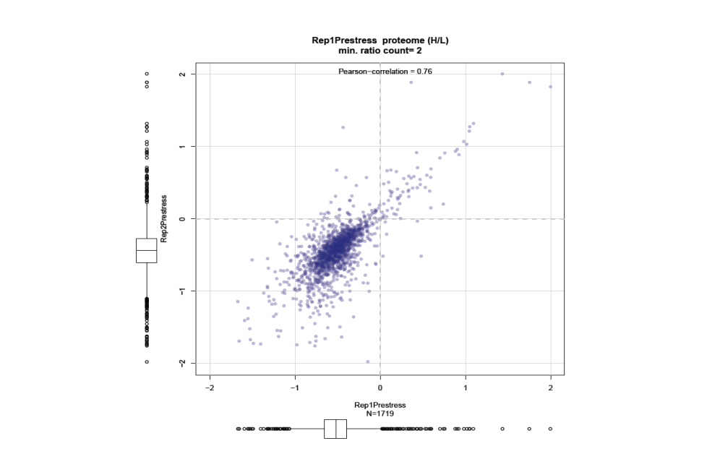
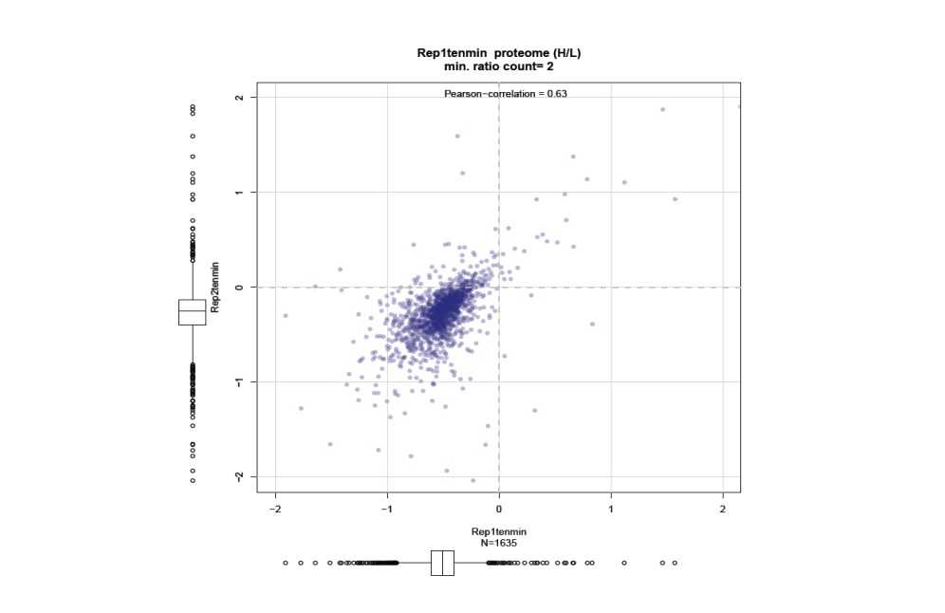
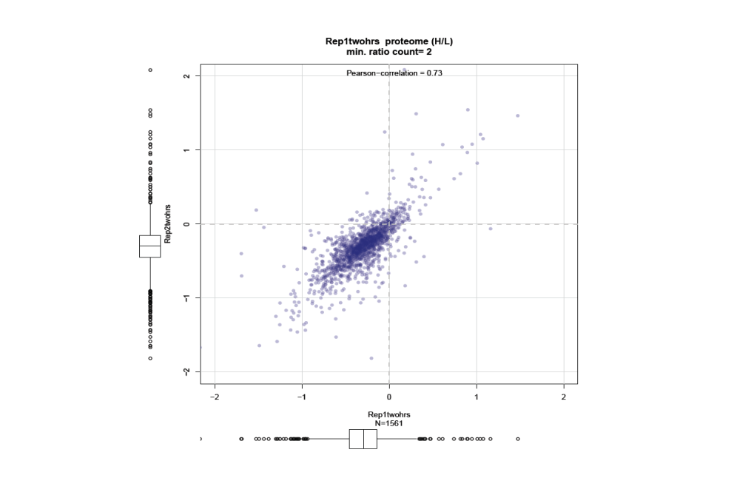
Pre-stress
10 min
120 min
Notes:
Supplementary Figure 10. Reproducibility between biological replicates. B. Pearson correlation between normalized protein ratios between biological replicates for all three growth phases during ethanol stress experiment.

Slide 13
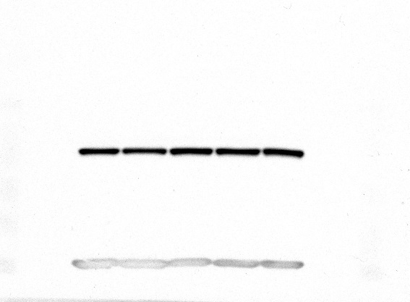
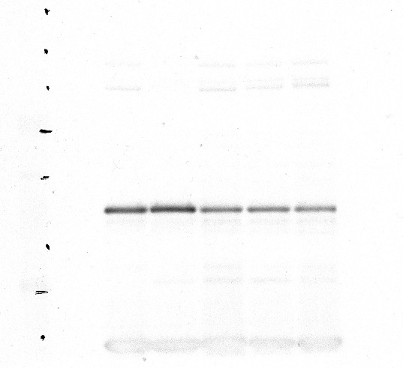

A.
B.
C.
GAPDH
OmpX
MBP
Log₁₀ of protein changes
Log₁₀ of protein changes
Log₁₀ of protein changes
Growth Stage
Growth Stage
Growth Stage
D.
Log₁₀ of protein changes
Log₁₀ of protein changes
Log₁₀ of protein changes
T1 T2 T3 T4 T5
T1 T2 T3 T4 T5
T1 T2 T3 T4 T5
Growth stage
Growth stage
Growth stage
55
25
55
kDa
GAPDH
kDa
OmpX
kDa
MBP
15
35
35
T1 T2 T3 T4 T5
T1 T2 T3 T4 T5
T1 T2 T3 T4 T5
Growth stage
Growth stage
Growth stage
Notes:
Supplementary Figure 11. Reproducibility of individual proteins during E.coli growth. Protein profiles of GAPDH (A.), OmpX (B.), and MalE (C.) obtained from this study correlated well with recently published MS/Western blot data from a previous study (D.) (Soares et al., 2013).

Slide 14
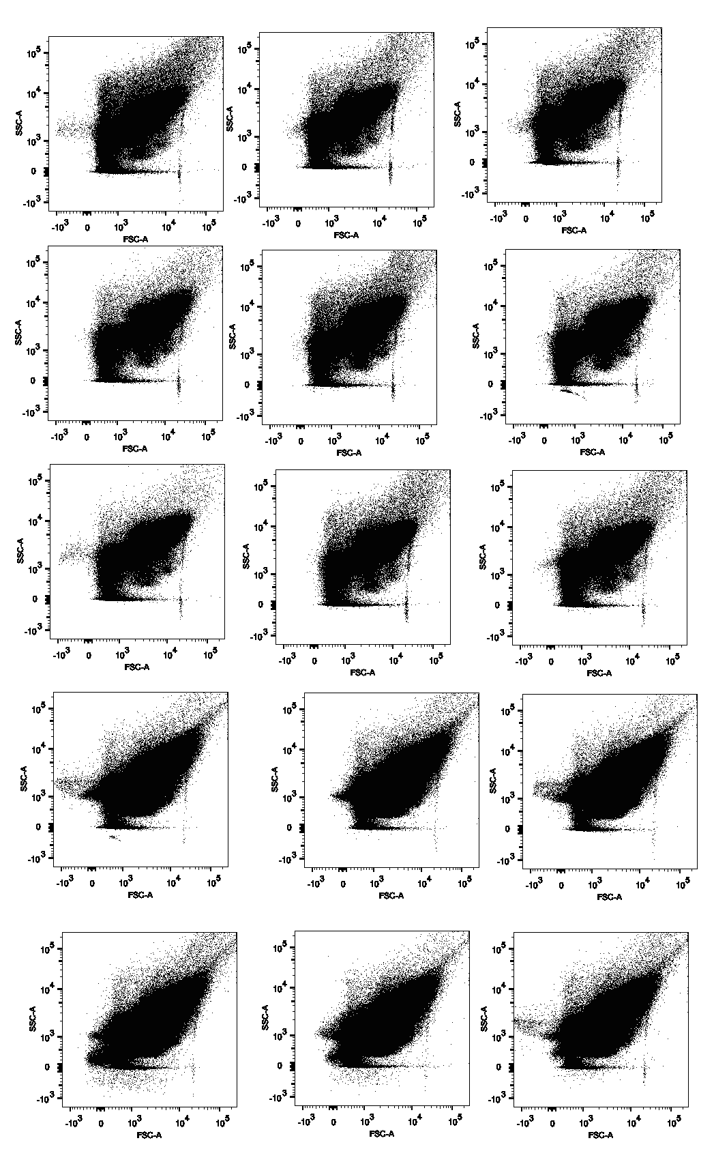
TP3
TP5
BR1-TR1
BR1-TR2
BR1-TR3
BR1-TR1
BR1-TR2
BR1-TR3
BR2-TR1
BR2-TR2
BR2-TR3
BR2-TR1
BR2-TR2
BR2-TR3
BR3-TR1
BR3-TR2
BR3-TR3
Notes:
Supplementary Figure 12. E.coli cell counting. Cells were counted using Fluorescence-activated Cell Sorting (FACS).Experiments were performed in biological duplicates (TP5) and triplicates (TP3) at an OD600 of 0.5(TP3) and 1.0(TP5) with good biological and technical reproducibility.

